Slide 1

Digital Portfolio
STUDENT NAME: HAVINASH.L
REGISTER NO:222401169
NMID: 97A3C5DAAE6C70992D84B2C572F0344E
DEPARTMENT: Bsc.Computer Science with Data Science
COLLEGE: DRBCCC'S HINDU COLLEGE/ UNIVERSITY OF MADRAS
1
Notes:
1

Slide 2

PROJECT TITLE
Figma Ui/ux designer
2

Slide 3



AGENDA
Problem Statement
Project Overview
End Users
Tools and Technologies
Portfolio design and Layout
Features and Functionality
Results and Screenshots
Conclusion
Github Link
3/21/2024 Annual Review
3

Slide 4

PROBLEM STATEMENT
Figma Ui/ux designer
Designers face challenges in creating user-friendly interfaces with real-time collaboration and consistent design systems. Figma helps by enabling seamless prototyping, collaboration, and usability testing across platforms.
4

Slide 5

PROJECT OVERVIEW
Designing
This project focuses on designing interactive, user-friendly interfaces using Figma. It involves creating wireframes, prototypes, and design systems to ensure consistency, usability, and real-time collaboration between designers, developers, and stakeholders. The goal is to deliver visually appealing and responsive designs for web and mobile platforms.
5

Slide 6

WHO ARE THE END USERS?
▪︎Clients/Businesses – who need the final product or website/app.
▪︎Developers – who use the designs for implementation.
▪︎Project Managers & Stakeholders – who review and approve designs.
▪︎End Customers/Users – who actually use the website/app designed.
6

Slide 7

TOOLS AND TECHNIQUES
Tools: Figma, FigJam, Plugins, Design Systems, Version Control.
Techniques: Wireframing, Prototyping, User Flow Mapping, Responsive Design, Collaboration.
7

Slide 8
Portfolio Design
Your portfolio has a clean, modern, and professional look with neat typography, simple colors, and a responsive structure. It’s visually appealing and highlights your skills, projects, and details clearly.
Portfolio Layout
The layout is organized into sections like:
Home → Introduction and name
About → Education and personal details
Projects → Showcasing your work
Contact → Easy way to reach you
This makes it easy to navigate and user-friendly on both desktop and mobile.
POTFOLIO DESIGN AND LAYOUT
8

Slide 9
FEATURES AND FUNCTIONALITY
Features: Clean design, organized sections, responsive layout, easy navigation, contact form.
Functionality: Works on all devices, smooth scrolling, project showcase, clickable links, mobile-friendly menu.

Slide 10
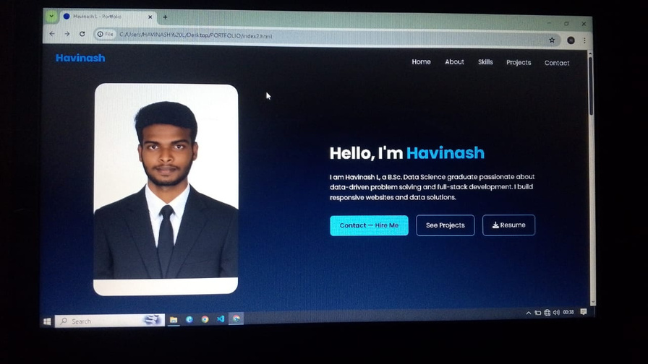

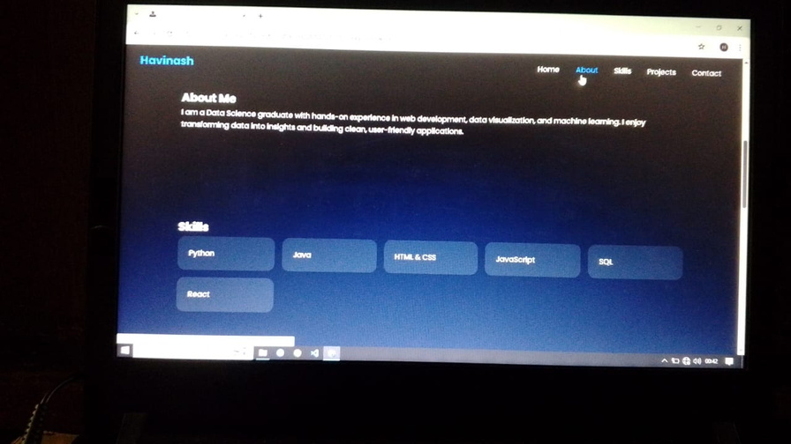
RESULTS AND SCREENSHOTS
HAVINASH.L
3/21/2024 Annual Review
10

Slide 11

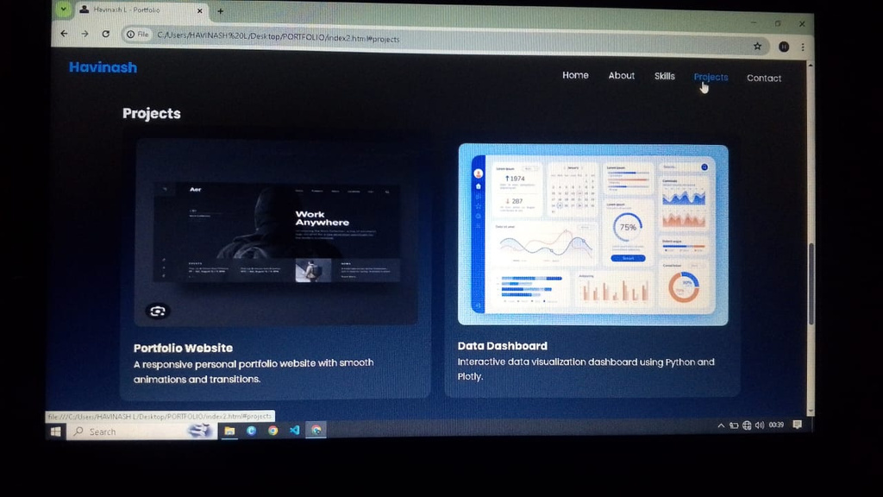
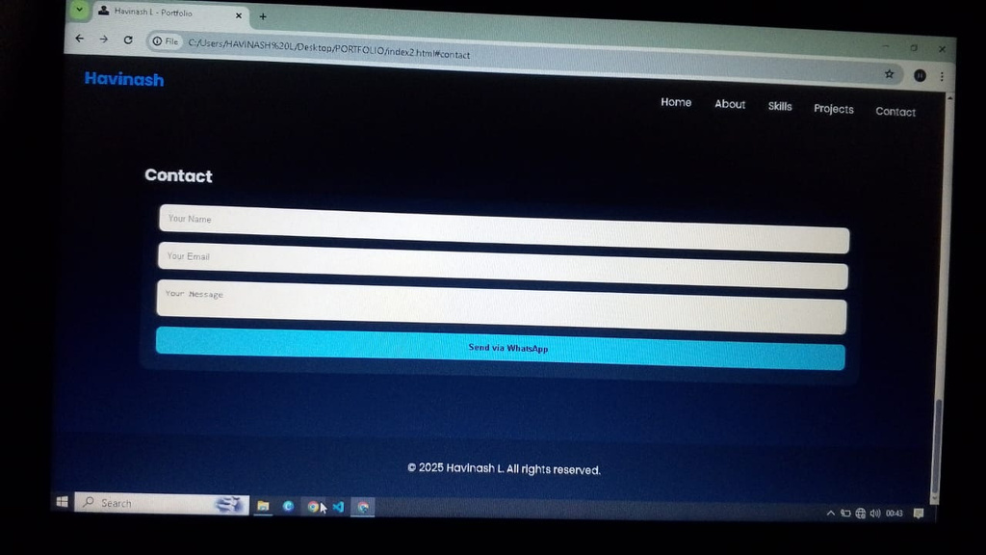
RESULTS AND SCREENSHOTS

Slide 12
CONCLUSION
This project helped in understanding the principles of UI/UX design and applying them effectively using Figma. By creating interactive and user-friendly interfaces, the project enhanced the overall user experience while maintaining a clean and modern design.
It also demonstrated the importance of usability, accessibility, and visual consistency in digital product
Thank you....
11

